Slide 1
R Ladies STL Introduction to Optimization
Ralph Asher
ralph@datadrivensupplychain.com
Copyright Data Driven Supply Chain LLC

Slide 2

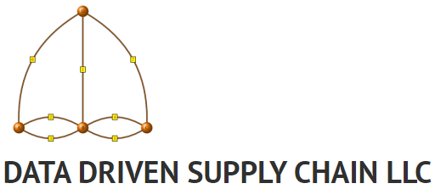
Who Am I?
BS Physics, MS Operations Research
US Marine Corps, 2006-2012 (Active Duty), 2013-Present (Part-Time / Reservist)
General Mills & Target: Supply Chain Design & Simulation (2013-2021)
Warehouse Network Design (General Mills)
Last-Mile Delivery Network Design (Target)
Data Driven Supply Chain LLC: Consulting & Training in Supply Chain Analytics, Design, Optimization and Simulation
www.datadrivensupplychain.com
Math, maps, and coding enthusiast since childhood
USSR, MS-DOS, BASIC, and other antiquated acronyms
Copyright Data Driven Supply Chain LLC

Slide 3
What is Optimization Modeling?
Optimization modeling is a mathematical technique that allows a practitioner to optimize a set of interconnected decisions, where the decisions are constrained by real-world limitations. Optimization solvers take the set of decisions, formulated as a mathematical model, and return the set of decisions that optimizes (minimizes or maximizes) an expression (“objective function”) that includes some or all the decisions as inputs.
Optimization Modeling is also called Mathematical Programming
Copyright Data Driven Supply Chain LLC

Slide 4
Optimization Modeling: Decision Variables
A modeler will define decision variables, numeric variables that either:
directly represent the decisions they want to make, or
facilitate the constraints.
The objective function is the expression in the optimization model that we want to minimize or maximize. It consists of some or all decision variables (with coefficients), plus a constant (incl zero)
When the optimization model is sent to specialized software (a “solver”), the solver will determine the values of all decision variables that yield the optimal value of the objective function.
Decision variables can be three main types:
Continuous: any real value, possibly within user-defined upper or lower bounds
Integer: any integer value, possibly within user-defined upper or lower bounds
Binary: only 0 or 1
Copyright Data Driven Supply Chain LLC

Slide 5
Optimization Model Types
The types of decision variables, and the form of the constraints and objective function, will determine what type optimization model you have.
Linear Programming (LP) model: only continuous decision variables, all constraints and the objective function are linear
Mixed Integer Linear Programming (MILP) model: at least some decision variables are binary or integer, all constraints and the objective function are linear
Nonlinear Programming (NLP) model: At least one term in the constraints or objective function are nonlinear (e.g., two decision variables multiplied by each other, or a decision variable raised to an exponent other than 1)
Mixed Integer Linear Programming is the dominant form of optimization modeling used in supply chain modeling
Copyright Data Driven Supply Chain LLC

Slide 6
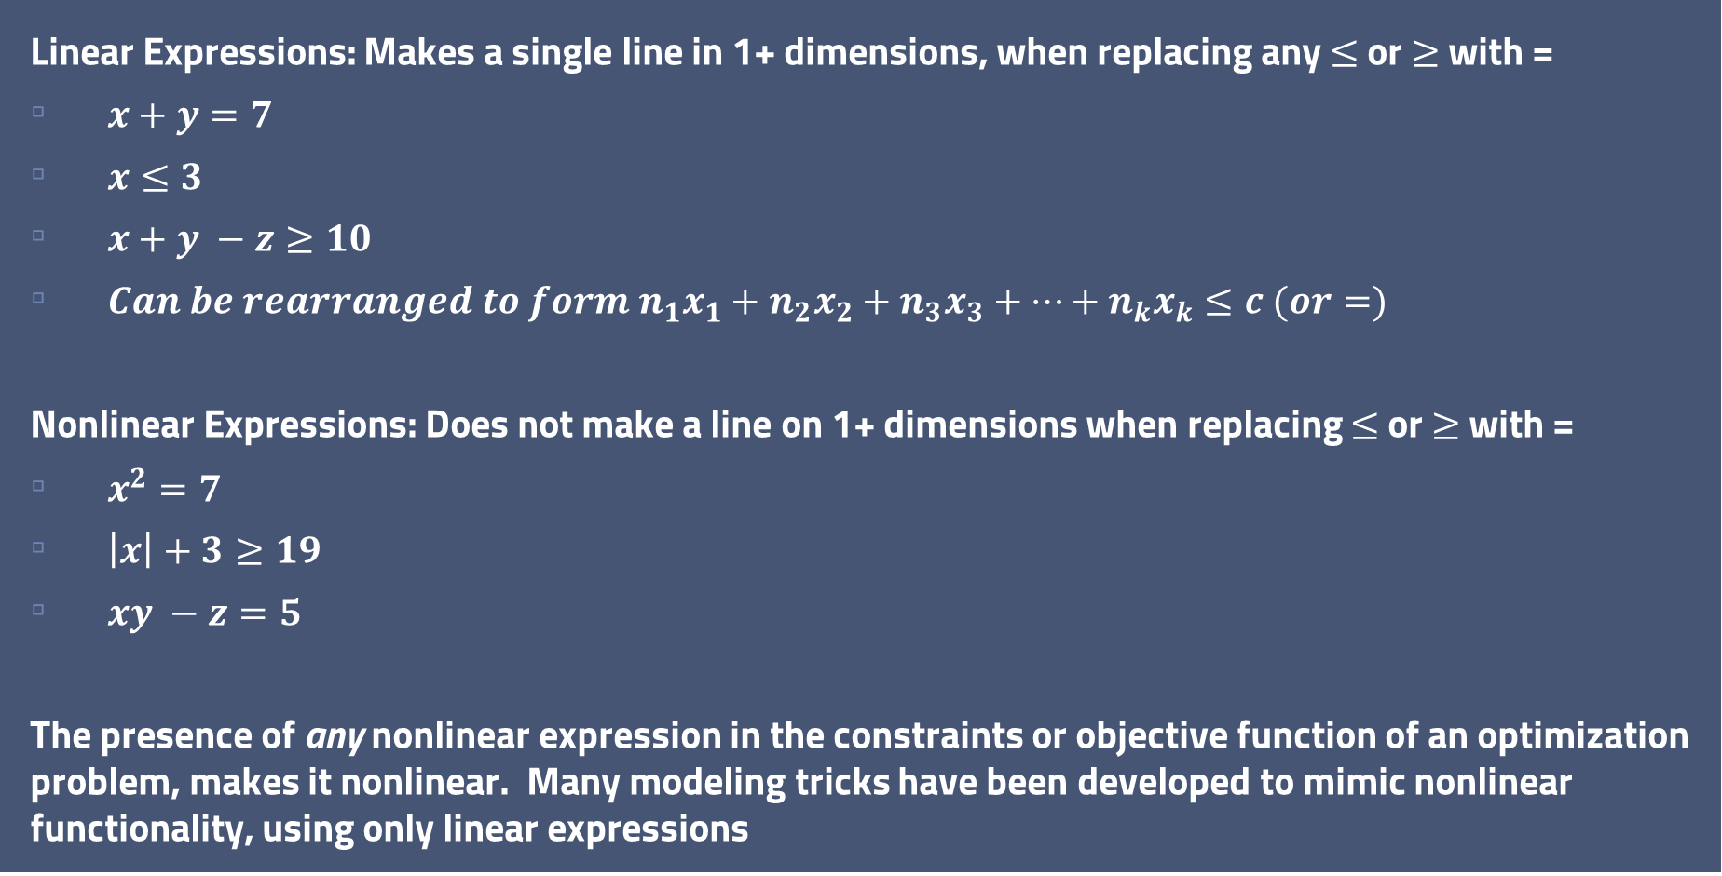
Linear and Nonlinear Expressions
Linear Expressions: Makes a single line in 1+ dimensions, when replacing any $≤$ or $≥$ with =
$x+y=7$
$x≤3$
$x+y −z≥10$
$Can be rearranged to form n_{1}x_{1}+{n_{2}x}_{2}+n_{3}x_{3}+…+n_{k}x_{k}≤c (or=)$
Nonlinear Expressions: Does not make a line on 1+ dimensions when replacing $≤$ or $≥$ with =
$x^{2}=7$
$\left|x\right|+3≥19$
$xy −z=5$
The presence of any nonlinear expression in the constraints or objective function of an optimization problem, makes it nonlinear. Many modeling tricks have been developed to mimic nonlinear functionality, using only linear expressions
Copyright Data Driven Supply Chain LLC

Slide 7
Linear Programming Introduction: Toy Shop Example
A modeler will define decision variables, variables that either:
directly represent the decisions they want to make, or
facilitate the constraints.
The objective function is the expression in the optimization model that we want to minimize or maximize. It consists of some or all decision variables, plus coefficients and/or constants.
Linear Programming (LP) model: only continuous decision variables, all constraints and the objective function are linear
In this example, we will make simplifying assumptions about the linearity of the real world, for teaching purposes!
Copyright Data Driven Supply Chain LLC

Slide 8
Linear Programming Introduction: Toy Shop Example
North Woods Toy Emporium is the premier toymaker in Minnesota. The store makes and sells their own product, and they only have two items: wooden cars and wooden trains. Each toy is prepared by hand.
Each car requires 5 hours of woodwork and 1 unit of wood. Each train requires 3 hours of woodwork and 1 unit of wood. The profit is $7 on each wooden car, and $4 on each wooden train. The expert toymaker in the shop has 40 hours a week for making toys, and due to supply limitations, only has 10 units of wood available each week.
How many wooden cars and wooden trains should be produced each week in order to maximize profit?
Discussion on Linear Programming Inputs:
What are the decisions?
What are the constraints?
What is the objective?
Copyright Data Driven Supply Chain LLC

Slide 9
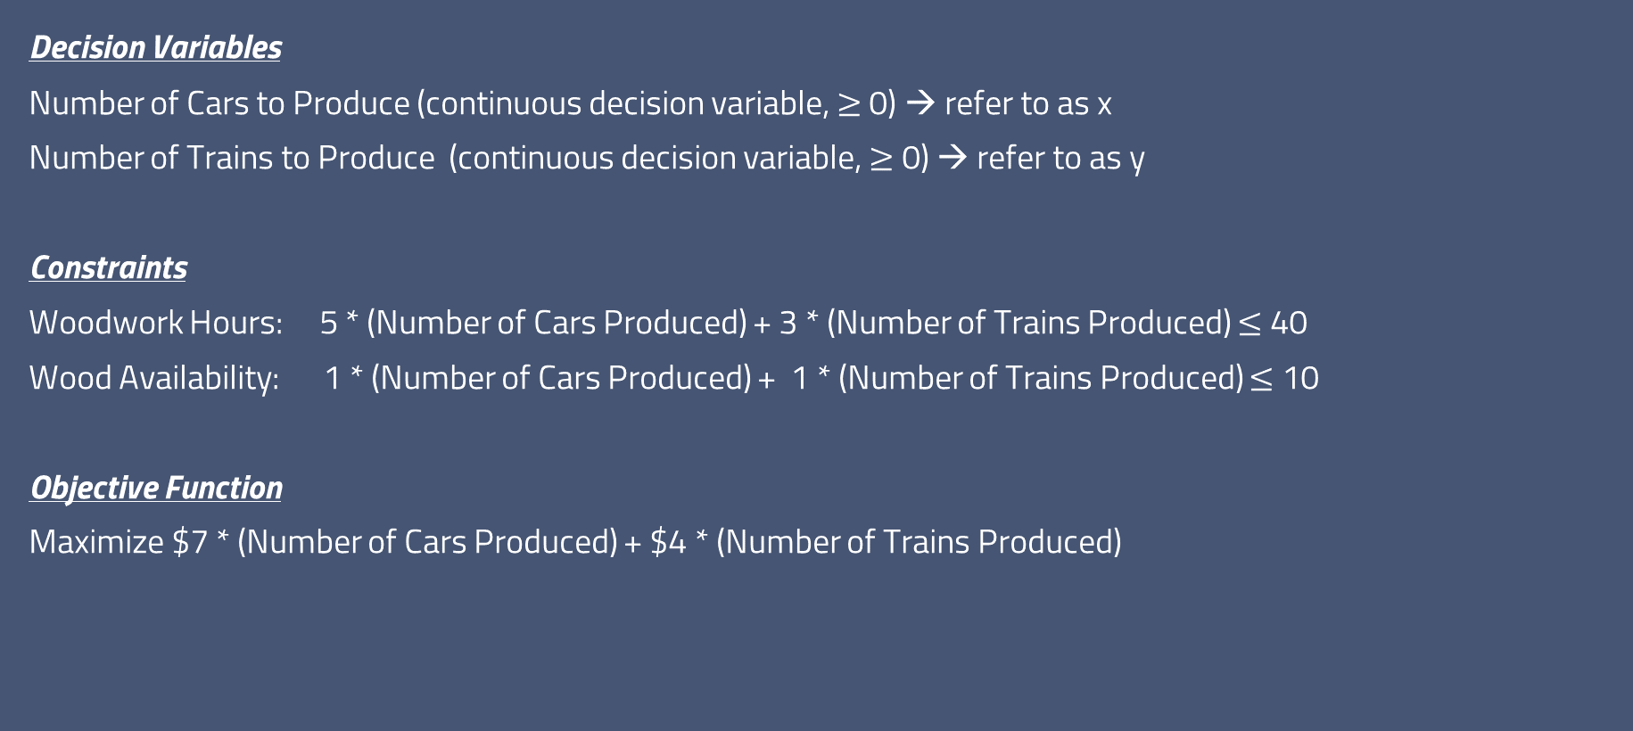
Linear Programming Introduction: Toy Shop Example
Decision Variables
Number of Cars to Produce (continuous decision variable, $≥$ 0) → refer to as x
Number of Trains to Produce (continuous decision variable, $≥$ 0) → refer to as y
Constraints
Woodwork Hours: 5 * (Number of Cars Produced) + 3 * (Number of Trains Produced) $≤$ 40
Wood Availability: 1 * (Number of Cars Produced) + 1 * (Number of Trains Produced) $≤$ 10
Objective Function
Maximize $7 * (Number of Cars Produced) + $4 * (Number of Trains Produced)
Copyright Data Driven Supply Chain LLC

Slide 10
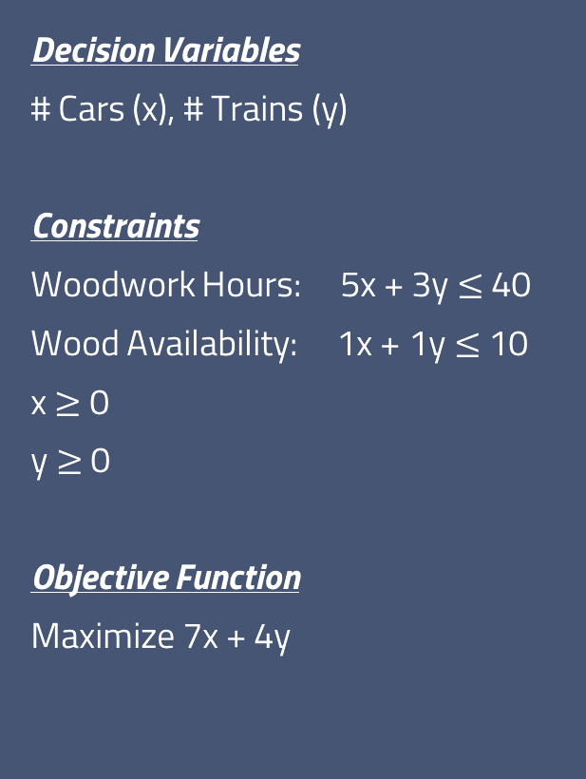
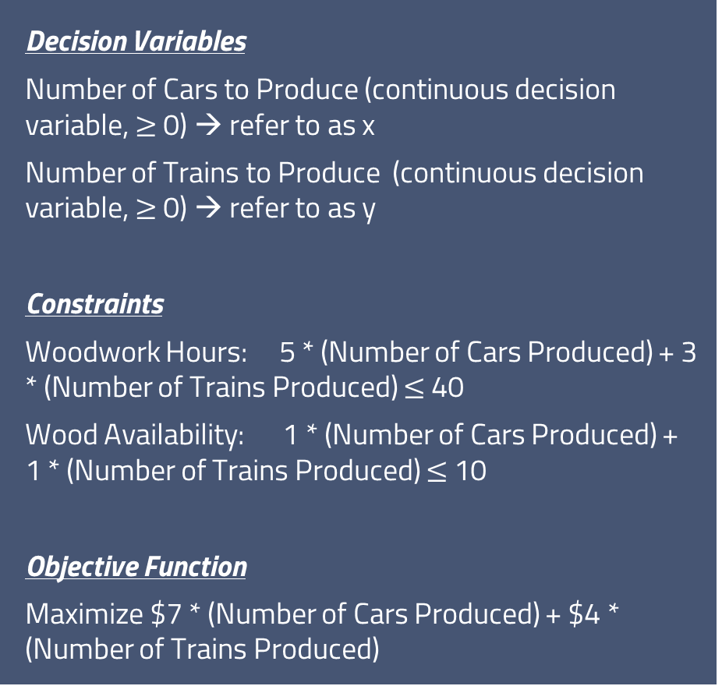
Linear Programming Introduction: Toy Shop Example
Decision Variables
Number of Cars to Produce (continuous decision variable, $≥$ 0) → refer to as x
Number of Trains to Produce (continuous decision variable, $≥$ 0) → refer to as y
Constraints
Woodwork Hours: 5 * (Number of Cars Produced) + 3 * (Number of Trains Produced) $≤$ 40
Wood Availability: 1 * (Number of Cars Produced) + 1 * (Number of Trains Produced) $≤$ 10
Objective Function
Maximize $7 * (Number of Cars Produced) + $4 * (Number of Trains Produced)
Decision Variables
# Cars (x), # Trains (y)
Constraints
Woodwork Hours: 5x + 3y $≤$ 40
Wood Availability: 1x + 1y $≤$ 10
x $≥$ 0
y $≥$ 0
Objective Function
Maximize 7x + 4y
Business Problem, Transformed to Optimization Problem
Copyright Data Driven Supply Chain LLC

Slide 11
Linear Programming Introduction: Toy Shop Example
In an optimization model, constraints are equality expressions and/or inequality expressions that define the limitations on the decision variables.
The objective function guides the search for the value of decision variables – those that maximize or minimize the objective – within the limitations on the decision variables that are set by the constraints.
The feasible region is the set of all possible decision variable values, that satisfy all constraints. Your optimal solution must fall within the feasible region, otherwise, one or more constraints are violated.
You can define constraints such that there is no feasible region – no set of decision variable values, will satisfy all constraints. You’ve put the model in an impossible situation – it is infeasible. If a model is infeasible, your solver will detect this, let you know, and no solution will be returned.
You can define constraints such that at least one decision variable can increase or decrease forever without limitation, and effectively, that your objective function can increase or decrease without limit. In this case, the model is unbounded – the objective function can grow without bound. If a model is unbounded, your solver will detect this, let you know, and no solution will be returned.
Copyright Data Driven Supply Chain LLC

Slide 12
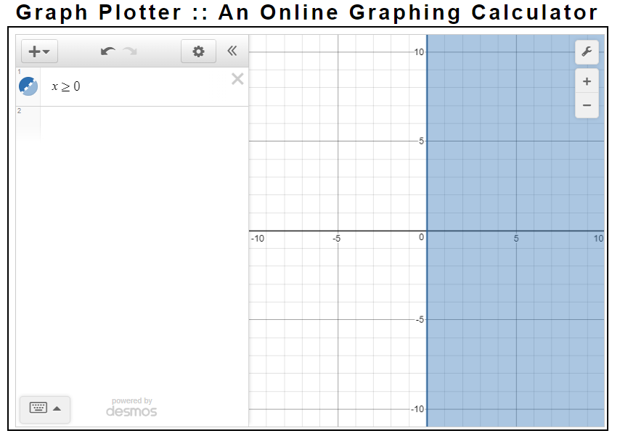
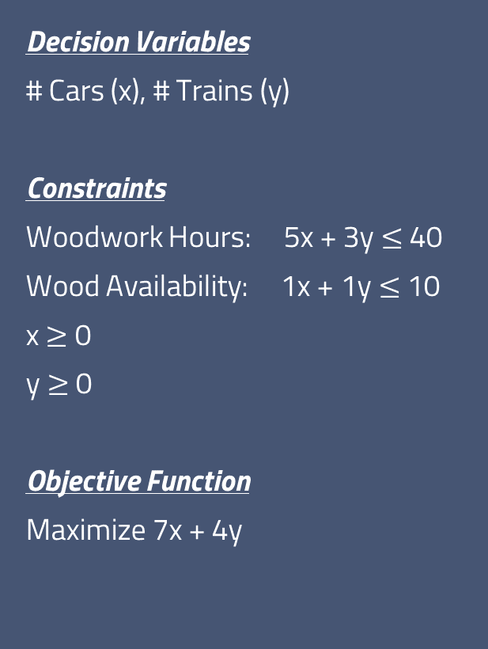
Linear Programming Introduction: Toy Shop Example
Decision Variables
# Cars (x), # Trains (y)
Constraints
Woodwork Hours: 5x + 3y $≤$ 40
Wood Availability: 1x + 1y $≤$ 10
x $≥$ 0
y $≥$ 0
Objective Function
Maximize 7x + 4y
Feasible Region with just x ≥ 0 constraint
Screenshots from https://www.transum.org/Maths/Activity/Graph/Desmos.asp

Slide 13
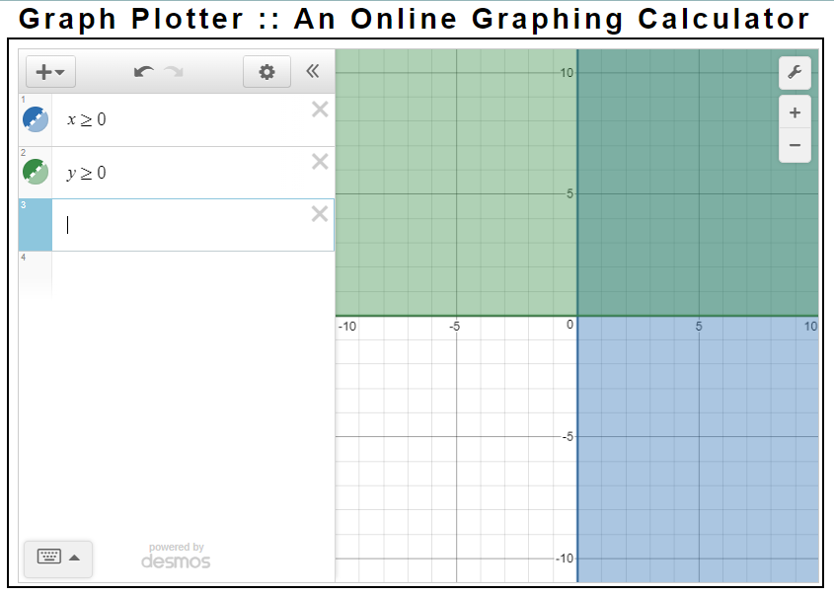
Linear Programming Introduction: Toy Shop Example
Decision Variables
# Cars (x), # Trains (y)
Constraints
Woodwork Hours: 5x + 3y $≤$ 40
Wood Availability: 1x + 1y $≤$ 10
x $≥$ 0
y $≥$ 0
Objective Function
Maximize 7x + 4y
Feasible Region with
x ≥ 0
y ≥ 0 constraints
Screenshots from https://www.transum.org/Maths/Activity/Graph/Desmos.asp

Slide 14
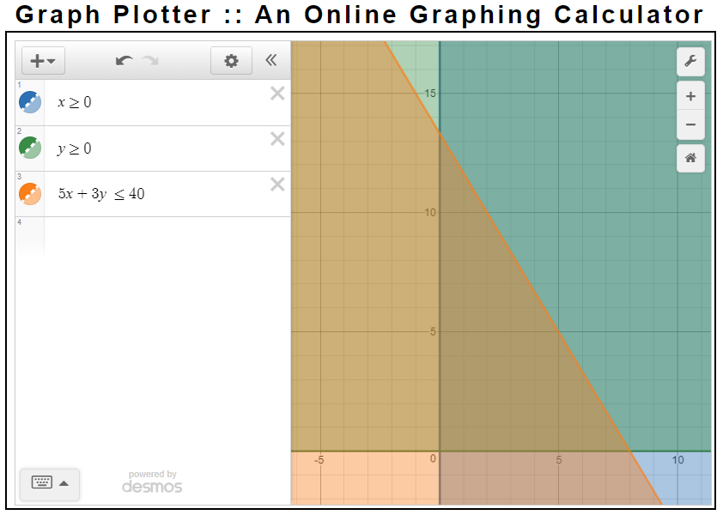
Linear Programming Introduction: Toy Shop Example
Decision Variables
# Cars (x), # Trains (y)
Constraints
Woodwork Hours: 5x + 3y $≤$ 40
Wood Availability: 1x + 1y $≤$ 10
x $≥$ 0
y $≥$ 0
Objective Function
Maximize 7x + 4y
Feasible Region with
x ≥ 0
y ≥ 0
5x + 3y ≤ 40
constraints
Screenshots from https://www.transum.org/Maths/Activity/Graph/Desmos.asp
Copyright Data Driven Supply Chain LLC

Slide 15
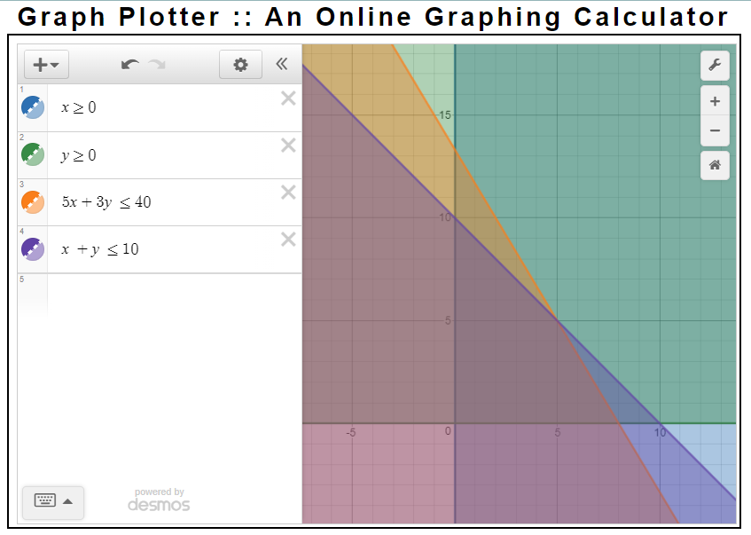
Linear Programming Introduction: Toy Shop Example
Decision Variables
# Cars (x), # Trains (y)
Constraints
Woodwork Hours: 5x + 3y $≤$ 40
Wood Availability: 1x + 1y $≤$ 10
x $≥$ 0
y $≥$ 0
Objective Function
Maximize 7x + 4y
Feasible Region with
x ≥ 0
y ≥ 0
5x + 3y ≤ 40
x + y ≤ 10
constraints
Screenshots from https://www.transum.org/Maths/Activity/Graph/Desmos.asp
Copyright Data Driven Supply Chain LLC

Slide 16
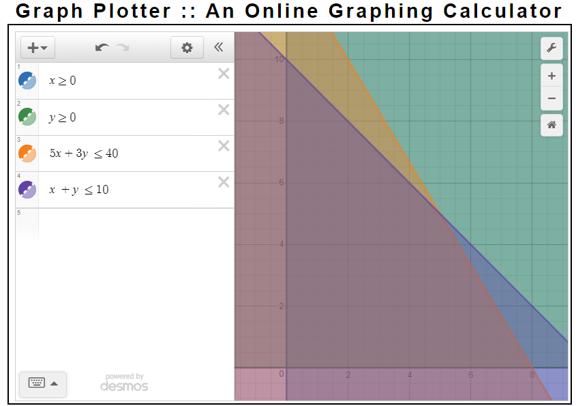
(0,10)
All points inside the polygon bounded by (0,0), (10,0), (5,5), and (8,0) , including points on the polygon edges themselves,
satisfy all the constraints.
In other words, any point inside this polygon lies in the feasible region and is a feasible solution.
This includes (0,0), not producing anything!!!
How do we proceed from “feasible” to the optimal solution?
(5,5)
Feasible Region
Objective Function
Maximize 7x + 4y
(0,0)
(8,0)
Copyright Data Driven Supply Chain LLC

Slide 17
(0,10)
In a linear program, the optimal solution can be found at a corner point.
This makes pure linear programs (no integer or binary variables) MUCH easier to solve than models with binary or integer variables!
In this case, the optimal objective value is $56, found at x=8, y=0. Produce 8 cars, zero trains
What is the objective values associated with the other corner points?
(5,5)
Feasible Region
Objective Function
Maximize 7x + 4y
(0,0)
(8,0)
Copyright Data Driven Supply Chain LLC

Slide 18
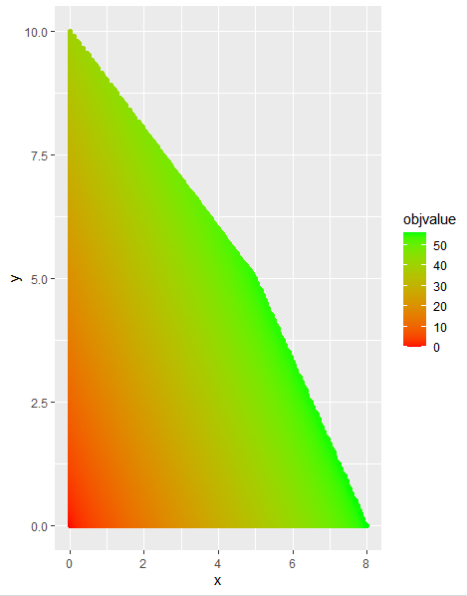
Feasible Region, Colored by Objective Function Value
Optimal solution (8,0) objective value 56
Copyright Data Driven Supply Chain LLC

Slide 19
Fundamentals of ompr
ompr (Optimization Modeling Package) is a R package, authored by Dirk Schumacher, for modeling Linear Programming and Mixed Integer Linear Programming problems in R
Available on CRAN
ompr enables a modeler to build flexible LP/MILP in R and connect to multiple different open-source and commercial solvers.
Vast improvement over lpSolve (another R package for linear optimization)
Data Prep: R
Model Building: ompr
Model Solve: glpk, cbc, Gurobi, CPLEX,etc.
Model Solution Extraction: ompr
Model Solution Postprocessing: R
Schumacher D (2022). ompr: Model and Solve Mixed Integer Linear Programs. R package version 1.0.2.9000, https://github.com/dirkschumacher/ompr.
Copyright Data Driven Supply Chain LLC

Slide 20
Fundamentals of ompr
Primary functions within ompr (from Github site):
MIPModel() create an empty mixed integer linear model. Always do this first!
add_variable() adds variables to a model Highly recommend declaring all variables right after creating the empty model!
add_constraint() add constraints
set_objective() sets the objective function of a model
set_bounds() sets bounds of variables (not always necessary)
solve_model() solves a model with a given solver
get_solution() returns the column solution (primal or dual) of a solved model for a given variable or group of variables
Schumacher D (2022). ompr: Model and Solve Mixed Integer Linear Programs. R package version 1.0.2.9000, https://github.com/dirkschumacher/ompr.
Copyright Data Driven Supply Chain LLC

Slide 21
ompr::add_variable()
add_variable(.model, .variable, ..., type = "continuous", lb = -Inf, ub = Inf)
Variable: text name of decision variable (without quotes), with or without indexing. If indexed, must give index range afterwards.
Type: “continuous”, “integer”, or “binary”.
lb (lower bound) and ub (upper bound): Initial constraints on values that the decision variables can take. In our toy shop example, both variables were ≥ 0, hence they had a lower bound of zero and an upper bound of Infinity. (Before taking into account the additional operational constraints on the decision variables).
Examples:
mymodel() %>% add_variable( myvar, type=‘continuous’, lb=0)
creates a single continuous decision variable named myvar
mymodel() %>% add_variable( myvar[j], j = 1:10, type=‘binary’)
creates ten decision variables, myvar[1], myvar[2], myvar[3], … myvar[10], all binary
Copyright Data Driven Supply Chain LLC

Slide 22
ompr::add_constraint()
add_constraint(.model, .constraint_expr, ..., .show_progress_bar = TRUE)
Constraints are linear equalities or inequalities of form == , ≤ , or ≥. Never < or >.
Constraints must include one or more decision variables, and can include constant or constants.
Constraints can include decision variables of multiple types (continuous, binary, and integer).
Examples:
mymodel() %>% add_constraint( x == 5) requires x to have a value of 5
mymodel() %>% add_constraint( x ≤ 5) requires x to have a value ≤ 5
mymodel() %>% add_constraint( x ≥ 3) requires x to have a value ≥ 3
mymodel() %>% add_constraint( x + y ≤ 7) requires x + y to have a value ≤ 7
mymodel() %>% add_constraint( x + y == 12) requires x + y to equal 12.
Copyright Data Driven Supply Chain LLC

Slide 23
ompr::set_objective()
set_objective(model, expression, sense = c("max", "min"))
expression is the objective function, a function of one or more decision variables. sense is whether the optimization solver should minimize or maximize the value of the objective function, within the constraints of the model.
Not all decision variables need to be part of the objective function. In many larger optimization models, only a small portion of the decision variables actually factor into the objective function.
Example:
mymodel() %>% set_objective( 5*x + 3*y, sense = ‘max’) maximizes 5x+3y
mymodel() %>% set_objective( 3*x, sense = ‘min’) minimizes 3x
mymodel() %>% set_objective( 3*y – 2*x - 17, sense = ‘max’) maximizes 3y – 2x - 17
Copyright Data Driven Supply Chain LLC

Slide 24
ompr::solve_model()
solve_model(model, solver)
Send the model (including defined variables, constraints, and objective function) to a solver.
The ROI.plugin.solver package must be installed and called via library(), where solver is specific to the actual solver you’re using: ROI.plugin.glpk, ROI.plugin.cbc, ROI.plugin.symphony, ROI.plugin.cplex, ROI.plugin.gurobi, etc.
Example:
mymodel() %>% solve_model(with_ROI(solver = "glpk")) Sends model to glpk solver, must have ROI.plugin.glpk package
Copyright Data Driven Supply Chain LLC

Slide 25
Activity:
Open Session 2, Exercise 1 Toyshop.Rmd
Copyright Data Driven Supply Chain LLC

Slide 26
Alternative Solutions
In a linear program, the optimization solver returns a solution that yields the optimal (highest or lowest) objective value.
There may be multiple, or infinitely many, solutions that yield the exact same optimal objective function. These are called alternative solutions and it’s not always easy to tell if they exist.
There also may be many more solutions that yield an objective function only marginally worse than the optimal objective function.
Part of the art of modeling is understanding where alternative solutions may exist, and if a solution that is slightly sub-optimal may actually be preferable from a business perspective.
Copyright Data Driven Supply Chain LLC

Slide 27
Alternative Solutions
Optimal solution (8,0) objective value 56
Copyright Data Driven Supply Chain LLC

Slide 28
Transportation Problem
The transportation Problem is a Linear Programming problem where the decision variables are how much product to ship from each origin (out of a set of origins) to each destination (out of a set of destinations). Each destination has a required amount of product (demand) and each origin has a maximum amount of product it can ship (capacity).
The objective function is calculated by multiplying the total volume from each origin to each destination, by the distance between the locations. The objective function is minimized.
Copyright Data Driven Supply Chain LLC

Slide 29
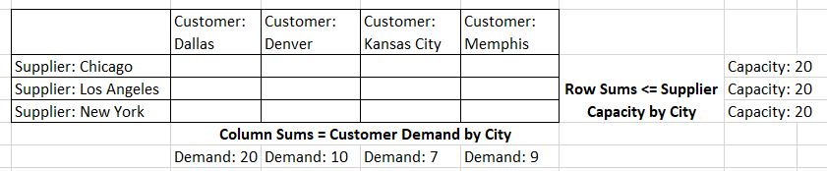
Transportation Problem
Decision Variables: How much to ship from each Supplier to each Customer?
Copyright Data Driven Supply Chain LLC

Slide 30
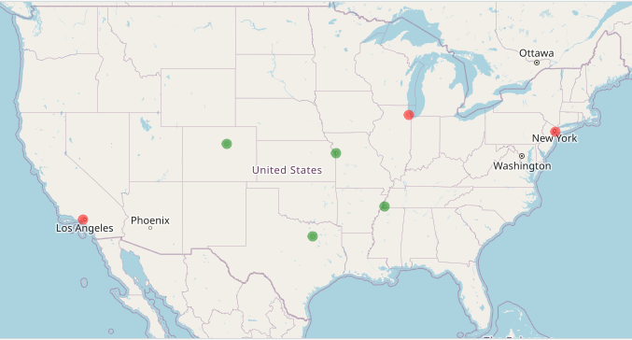
Transportation Problem
Copyright Data Driven Supply Chain LLC
 | Customer: Dallas | Customer: Denver | Customer: Kansas City | Customer: Memphis
Supplier: Chicago | 1286 km | 1466 km | 656 km | 774 km
Supplier: Los Angeles | 2014 km | 1358 km | 2199 km | 2598 km
Supplier: New York | 2210 km | 2621 km | 1767 km | 1539 km
Red: Suppliers
Green: Customers

Slide 31
Activity:
Open Session 2, Exercise 2 Transportation Problem.Rmd
Copyright Data Driven Supply Chain LLC

Slide 32
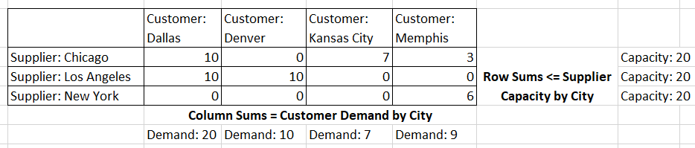
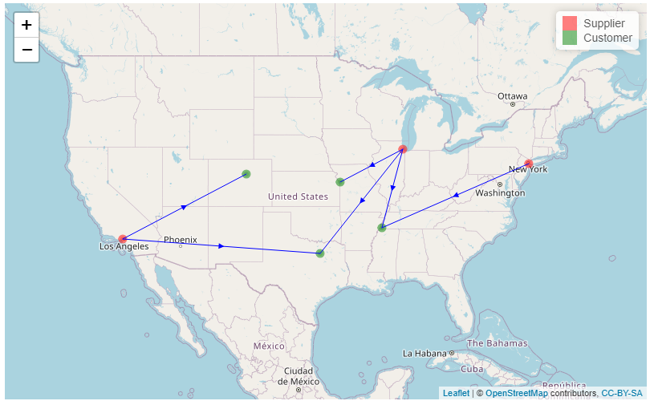
Transportation Problem
Copyright Data Driven Supply Chain LLC
Red: Suppliers
Green: Customers

Slide 33
Integer Variables

Slide 34
Why Integer Variables?
Decision variables can be three main types:
Continuous: any real value, possibly within user-defined upper or lower bounds
Integer: any integer value, possibly within user-defined upper or lower bounds
Binary: only 0 or 1
In general, the fewer integer or binary decision variables a problem has, the faster it will solve to optimality.
If possible, you usually want to formulate your model entirely with continuous decision variables.
However, there are many real-world situations where a modeler must use integer or binary decision variables to effectively recommend decisions using the optimization model.

Slide 35
Why Integer Variables?
Integer decision variables often are used in situations where using continuous decision variables doesn’t make sense. For example, in our last toy shop example, the optimal mix of toys to produce was 5 cars and 2.5 airplanes. How does one make 2.5 airplanes?
In some modeling contexts, it’s acceptable to use continuous decision variables to represent what are discrete values. If a model says for a plant to produce 714,229.33 units, it’s probably acceptable to round down to 714,229 without significantly degrading the optimality of the plan.
But in other cases, rounding isn’t acceptable! In which case, you need to use integer decision variables instead of continuous decision variables.

Slide 36
Why Integer Variables?
Integer decision variables often are used in situations where using continuous decision variables doesn’t make sense. For example, in our last toy shop example, the optimal mix of toys to produce was 5 cars and 2.5 airplanes. How does one make 2.5 airplanes?
In some modeling contexts, it’s acceptable to use continuous decision variables to represent what are discrete values. If a model says for a manufacturing plant to produce 714,229.33 widgets, it’s probably acceptable to round down to 714,229 without significantly degrading the optimality of the plan.
But in other cases, rounding isn’t acceptable! In which case, you need to use integer decision variables instead of continuous decision variables.

Slide 37
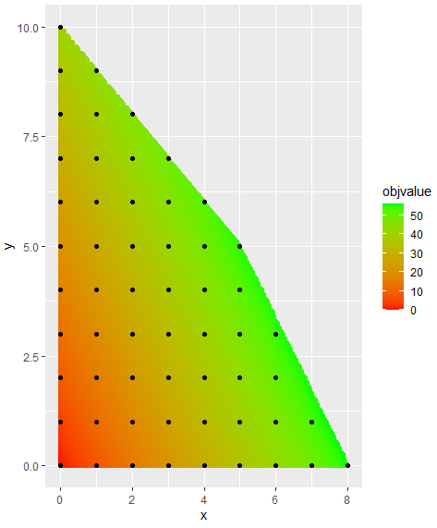
Integer Solutions to the Cars & Trains Problem
Optimal solution (8,0) objective value 56
Luckily, the optimal solution for the continuous variable problem is also an integer solution… but we’re rarely that lucky!

Slide 38
Optimality Gaps In Integer Programming
Optimization models with only continuous decision variables, can always be solved to optimality by searching the corner points (like in our previous toy example).
When integer or binary variables are introduced, that certainty no longer applies. Instead, optimization solvers:
Find solutions (feasible values of the decision variables) that meet all constraints
Find the objective value of those solutions
Compare that objective value, to the absolute best (lowest or highest) objective value that may exist for the problem
Repeat until the integer solution is “good enough”
The difference between the current (“incumbent”) solution’s objective value, and the theoretical best objective value, is called the optimality gap and is expressed as a percentage.
For Mixed Integer Linear Programs, solvers usually are set to stop when the optimality gap is at a threshold percentage (1% or 5% are common) or lower. Thus, the returned solution may not actually be the optimal solution, but a “good enough” solution.

Slide 39
Activity:
Open Session 3, Exercise 1 Toyshop Integer.Rmd

Slide 40
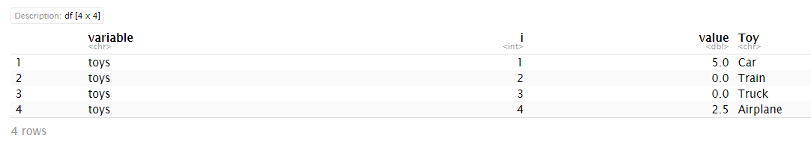
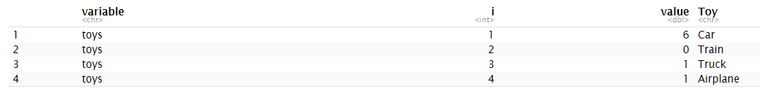
Comparing Continuous Vs. Integer Decision Variable Results
Continuous Decision Variables,
Objective Function 57.5
Integer Decision Variables, Objective Function 57

Slide 41
Why Binary Variables?
In optimization modeling, you may need to model decisions that are, fundamentally, a yes/no question.
Should I open a new warehouse in City X, yes or no?
Should I engage a new manufacturer located in City Y, yes or no?
In these circumstances, there are usually positive and negative impacts to either a Yes or a No. For example, opening a new warehouse near a major market may help lower your total delivery cost (good!) but there are startup capital costs (bad!) You want your decision – yes or no – to reflect those puts and takes.
Binary decision variables are integer variables that only can take the values of 0 or 1. In most supply chain modeling, 1 represents the presence of a facility (e.g., opening, or keeping open, a plant or warehouse) whereas 0 represents a closure or non-opening.
Binary variables are used in many other technical circumstances, particularly to enable specific types of constraints.

Slide 42
Why Binary Variables?
Objective Function With Binary Variables
Suppose y is a binary decision variable, representing whether to open (y=1) or not open (y=0) a warehouse. Opening the warehouse will cost $1,000,000. You want the opening cost of the warehouse to be included in your overall cost – the objective function.
To do this, you would include a term in the objective function:
{rest of objective function} + 1000000y
If the model opens the warehouse (y=1), then $1,000,000 will be added to the objective function. If the model does not open the warehouse (y=0), then nothing will be added to the objective function.

Slide 43
Questions?
Copyright Data Driven Supply Chain LLC

Slide 44
Thank you for listening!
ralph@datadrivensupplychain.com
www.datadrivensupplychain.com
https://www.linkedin.com/company/data-driven-supply-chain
https://www.linkedin.com/in/ralphasher/

